Slide 1
Selling on Value (Don’t Sell on Price)
Notes:
Our product goes far above and beyond what other point-of-sale systems can do.
To account for that we’ve created a best-in-breed solution, we have priced it accordingly.
While we are not the most expensive POS system out there, we also do not attempt to sell on low price.
Instead, we sell on the value we provide to our customers.
Here we explain how we sell based on that value provided.

Slide 2
Value of Revel
Employee Productivity
Managing Sales Data
Open Infrastructure
Fail Safe Processing
Intuitive User Interface for Fast Training

Slide 3
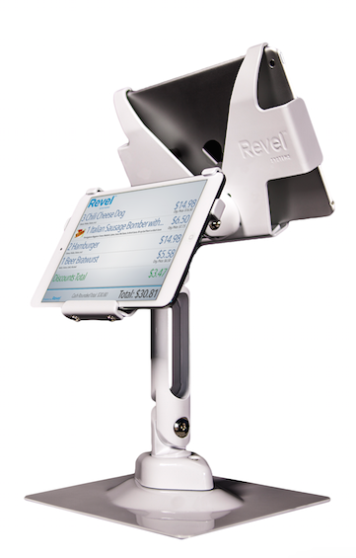
Selling on Value (Don’t Sell on Price)
Explaining how Revel’s POS system
can create value
Example – Minimizing the number of items employees forget to charge for
Notes:
Example – Minimizing the number of items employees forget to charge for
In this example, someone orders a drink. If an employee walks over to a bar to verbally tell or hand a note to the bartender, there’s a higher chance the drink is never paid for as it is then forgotten on final bill. This would not happen if that drink is entered in a POS that routes to a bar printer.
If a part time employee forgets to charge for a $10 drink three times a day, four times a week, that would be $120 per week.
For ten employees working for 40 weeks per year, $120 x 40 weeks x 10 employees is close to $50,000/year!!
That more than pays for a POS.
Share this next time a mom and pop says they can’t afford a POS and are sticking to pen and paper. It’s not confusing.

Slide 4
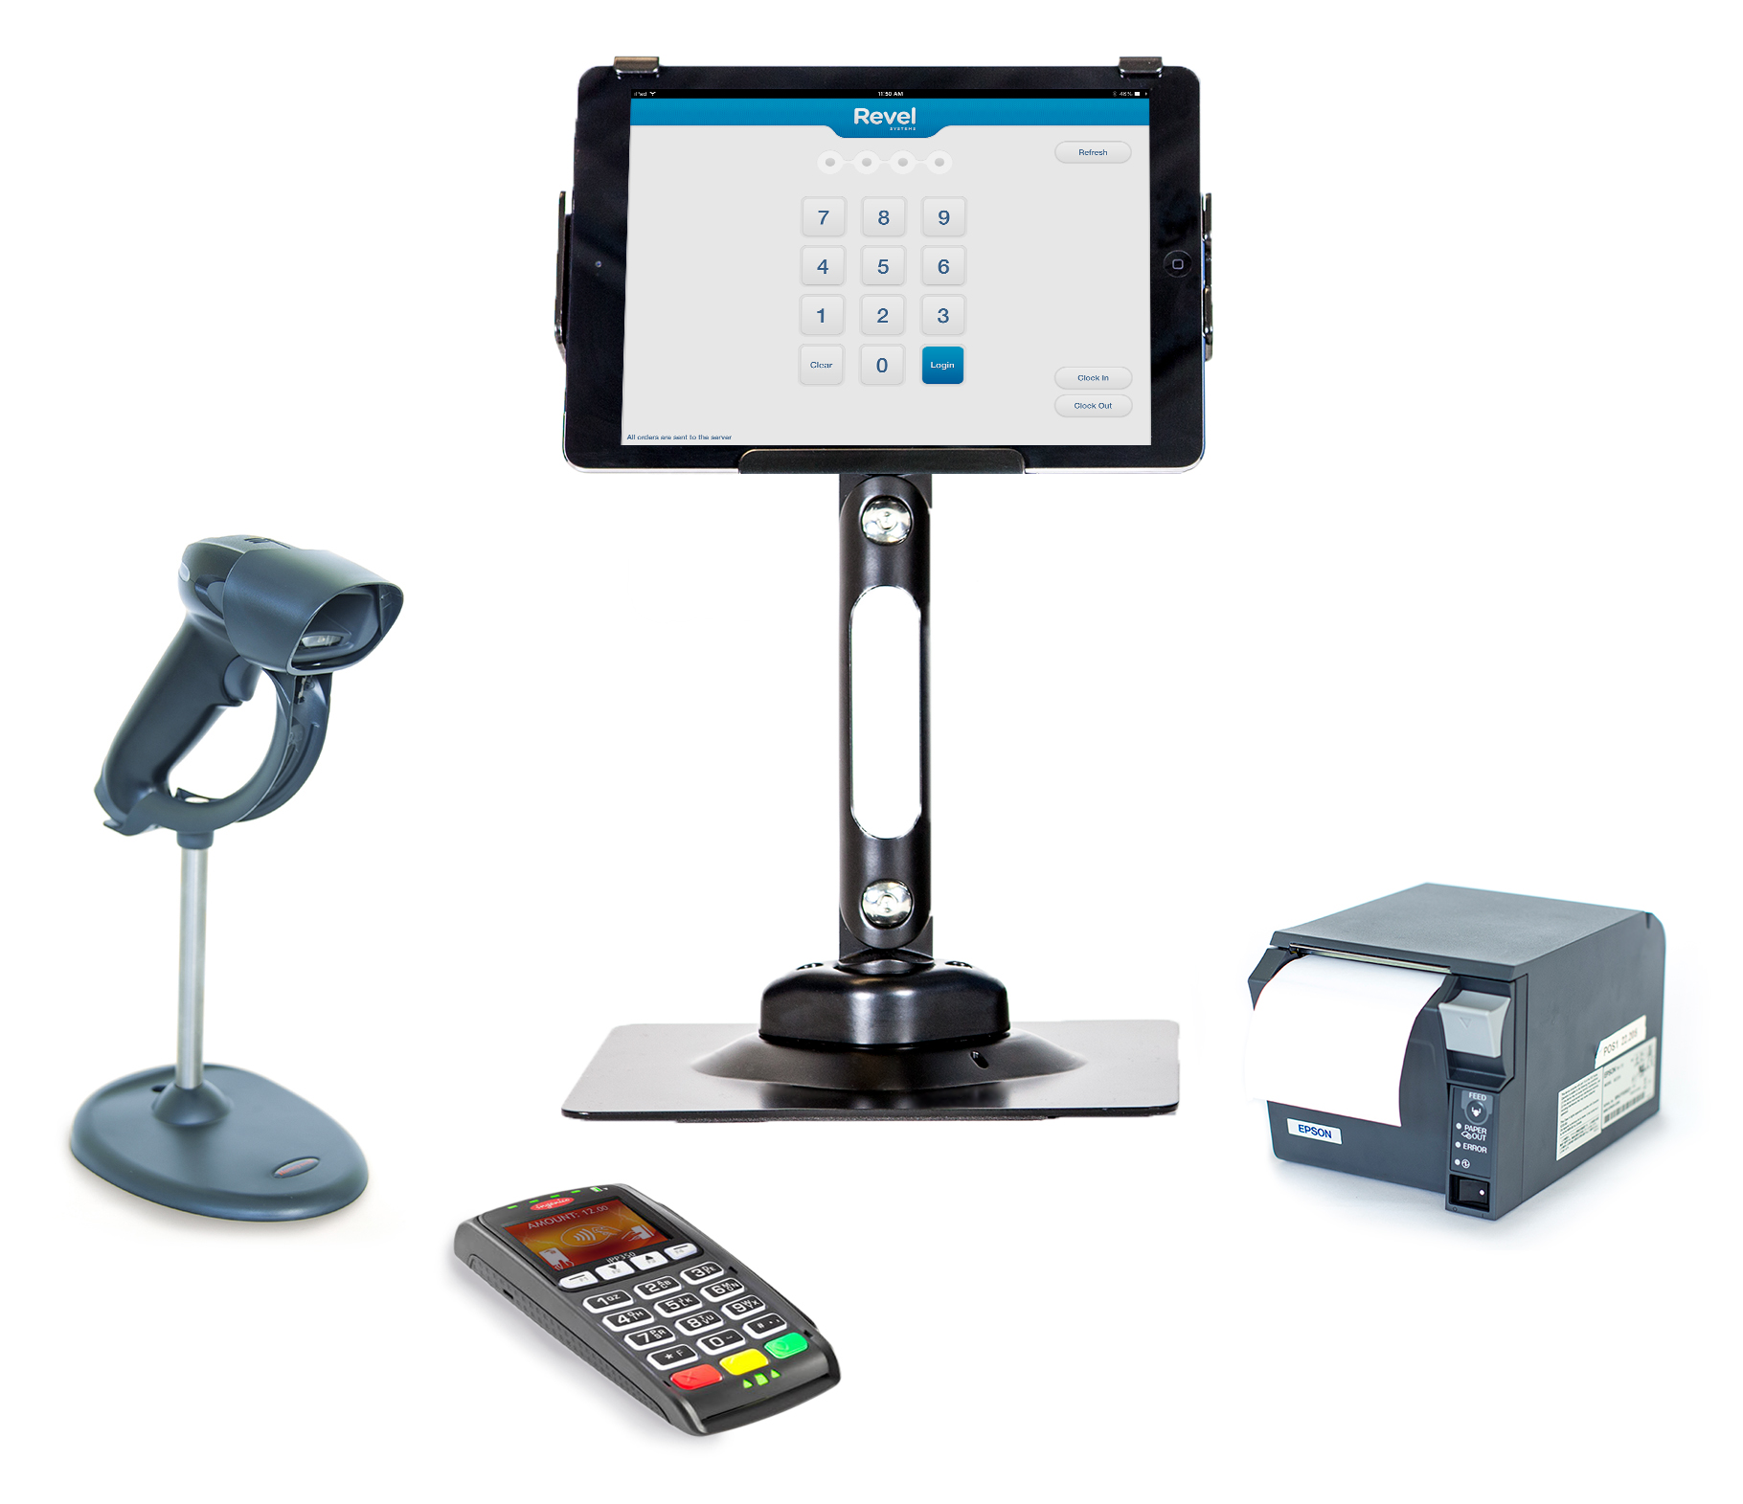
Selling on Value (Don’t Sell on Price)
Dedicated Database for
Every Customer
Custom System Setup
Own Your Data
Investment in Development
Notes:
Dedicated Database for Every Customer
Every other tablet player on the market stores all their clients on 1 database (not stable), while Revel creates a unique database for every client.
This is costly, but ensures long-term stability, and is why Revel doesn’t suffer from spontaneous spurts of mass-outages.
It also enables us to support large clients.
Think of it as a highway - other players put all of their clients in one lane; Revel builds a new lane for each client so they never get congested.
Custom System Setup
Once you’ve bought, they ship you the standard system, and that’s it. With Revel, it is a different story, our clients are paying for a custom-built, dedicated solution.
Revel offers more features and functionality than any other system on the market.
We customize that functionality to fit your needs.
An implementation manager is assigned to each case to make sure the system is optimized, with exactly the features your business wants.
Own Your Data
With your software license you are buying your backend, including all of your data, in exportable form.
Investment in Development
Revel is a profitable company that continuously reinvests profit in R&D.
This isn’t just a simple piece of hardware, but an ongoing partnership with Revel, who commits to continuous development and enhancements.

Slide 5
Selling on Value (Don’t Sell on Price)
Step 1 – Establish Value
We are looking at a long term relationship with the client. Our monthly fee is far from crazy.
What kind of system are they currently using? If they are using a legacy system, they spent the same amount on servers as they would on our monthly charges, if not more.
Plus we don’t want to do a pretty good job, we want to provide them with the top of the line iPad Point of Sale system on the market.
Notes:
The item we get pushed back about the most is the monthly fee.
The monthly fee surprises some people and it’s something we need to be prepared and ready for.
The first way to address this is to establish that Revel’s POS provides continuing value, and that our service does not end at installation.
Step 1 – Establish Value
(bullet points)

Slide 6
Selling on Value (Don’t Sell on Price)
Step 2 – Only Negotiate if Needed
Understand the perspective (s)he is coming from
In the case of legacy, explain that this is a different world; cloud based point of sale means no more back office server and everything is in the cloud. This means, along with other benefits:
  Real time reporting
  Managing your shop from anywhere in the world
  Free upgrades
  Server maintenance
You can also explain the security benefits such as no credit card data being saved, unlike back office legacy systems
Notes:
The monthly fee of course is a large part of our revenue.
We do not leave a whole lot of room for negotiation on the monthly fee.
Step 2 – Only Negotiate if Needed
Here, we want to re-emphasize the benefits in both:
Having data in the clouds and the real-time reporting capability this allows, and
Security benefits of credit card data not being saved
These benefits are not offered by legacy systems which have the onsite server

Slide 7
Selling on Value (Don’t Sell on Price)
Selling the features and values that make Revel unique
Having a better understanding of what our competitors offer and what sets us apart
Not being shy or elusive about the cost of the system
Being confident in our pricing and unapologetic about the value they will receive
Notes:
In our four years in business, we’ve been able to determine what has worked and what has not worked in selling our systems.
With regard to the value we provide, what has worked for us are the following:
Selling the features and values that make Revel unique
We provide a lot of functions and utility that our competitors do not.
This has value.
Having a better understanding of what our competitors offer and what sets us apart
Understanding the strengths and weaknesses of our competitors and selling against those.
Not being shy or elusive about the cost of the system
Being upfront about the pricing of the system
Having the understanding that there is value from our systems that are clients will receive above and beyond the system pricing
Being confident in our pricing and unapologetic about the value they will receive
Stating confidently that our product is worth the price and that they will receive immediate value from it

Slide 8
Selling on Value (Don’t Sell on Price)
Sending full price quotes to customers that you are certain
will be price sensitive.
Sending a quote before discussing price on the phone.
When discussing price on the phone, you can:
  Respond to pricing concerns immediately
  Sell on value
  Get a better idea of what the customer will be able to do
  Determine who else the customer is looking at for their solution.
Notes:
What hasn’t worked for us has been giving quotes before talking to the prospect about the business, and about pricing.
(bullet points)

